Slide 1

Exam AZ-304: Microsoft Azure Architect Design Crash Course
Tim Warner

Slide 2


Tim Warner
Based in Nashville, TN, US
MCT, MVP
Twitter: @TechTrainerTim
Badge: timw.info

Slide 3
Course Materials
timw.info/az304

Slide 4
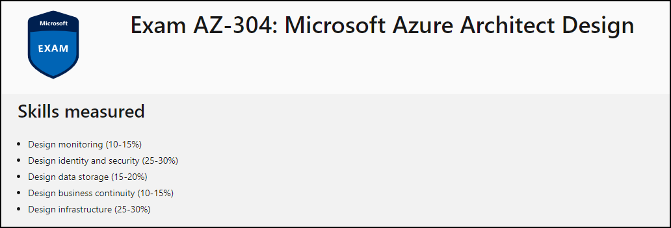
Learning Goals

Slide 5
Session 1
Design identity and security
Design data storage
Design monitoring

Slide 6
Session 2
Design business continuity
Design infrastructure
Azure Architect certification prep tips and tricks

Slide 7
Setting Expectations
Azure Architect is an expert-level certification
You should already know how to deploy and configure Azure resources
This is a "crash course"
Please plan to review these materials more than once
Recording takes ~24 hours to process
Five-minute break at midpoint
Please ask/answer questions and provide feedback in the Q/A panel, not the group chat

Slide 8

Course Recordings

Slide 9

Course Recordings

Slide 10
2020 Exam Update Information
Microsoft Worldwide Learning (WWL) revisits the Azure role-based certs yearly
Relevant blog post: timw.info/az2020
AZ-304 is available now
AZ-301 retires around September 30, 2020

Slide 11
Tim's Certification Study Pyramid
Interdependence
Content knowledge
Practical application
Test-taking skills

Slide 12
Authentication

Slide 13

Hybrid Identity

Slide 14

Passthrough Authentication

Slide 15

Seamless Single Sign-on

Slide 16
Azure Storage

Slide 17
Storage Account Replication
1
3
3
2
LRS
ZRS

Slide 18
Storage Account Replication
1
3
1
3
2
2
GRS – RA/GRS

Slide 19
Azure Compute

Slide 20
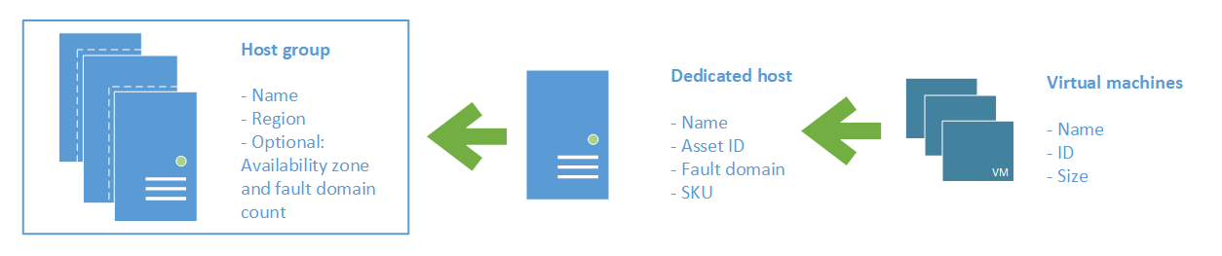
Azure VM Dedicated Host

Slide 21
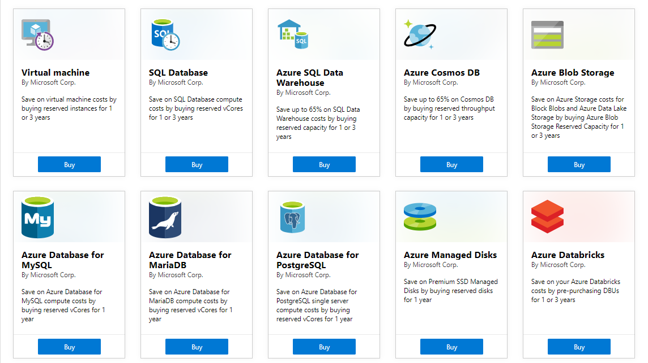
Azure Reservations

Slide 22

VM Scale Sets

Slide 23
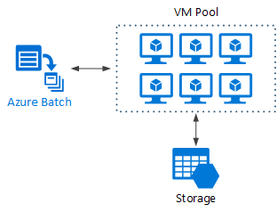
Azure Batch

Slide 24

Availability Set

Slide 25

Availability Zone

Slide 26
Migration and Disaster Recovery

Slide 27
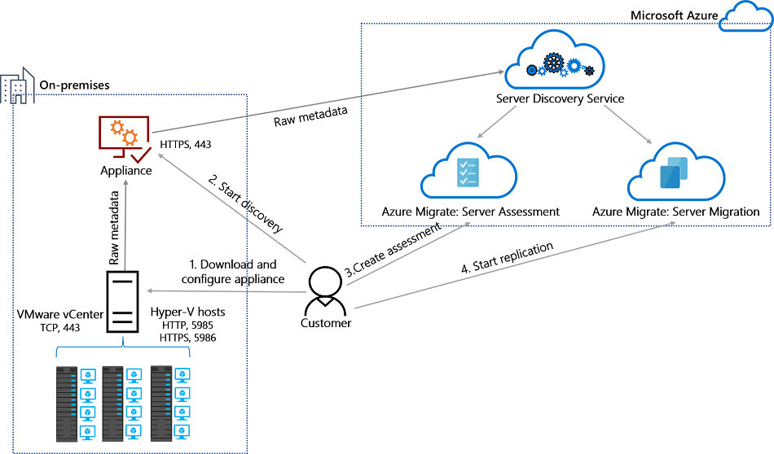
Azure Migrate

Slide 28

Azure Backup

Slide 29

Azure Site Recovery

Slide 30
Load Balancing

Slide 31

VM Networking

Slide 32

Load Balancing

Slide 33

VNet Peering

Slide 34

Hybrid Networking

Slide 35

Network Virtual Appliance

Slide 36

Azure Load Balancer

Slide 37

Application Gateway

Slide 38

Traffic Manager

Slide 39

Front Door Service

Slide 40
Governance

Slide 41

Tenant vs. Subscription

Slide 42

Azure Management Scopes
/ Tenant Root

Slide 43
App Architecture

Slide 44


Docker Container Lifecycle
https://timw.info/3635f

Slide 45

Event Architecture

Slide 46
Data Platform

Slide 47

Always Encrypted

Slide 48
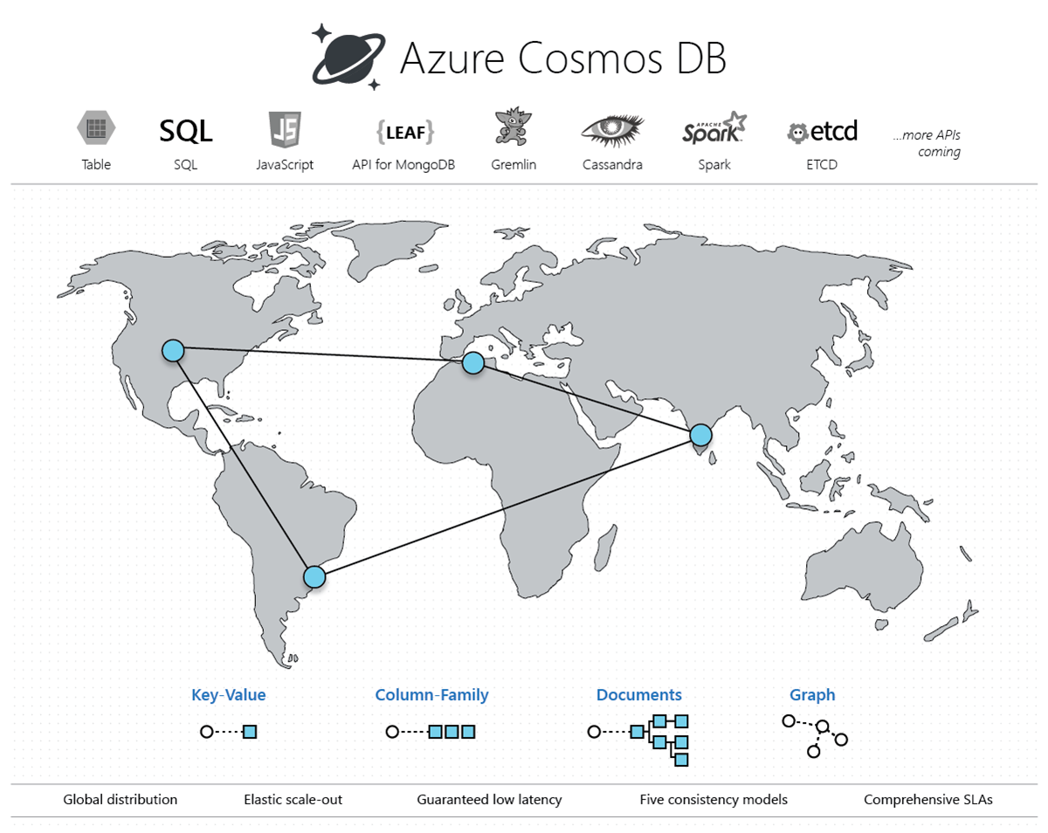
Cosmos DB

Slide 49
Exam AZ-304 Item Types

Slide 50

Multiple Choice

Slide 51
Repeated Scenario
You need to move an Azure VM to another hardware host.
Solution: You redeploy the VM.
Does this solution meet the goal?
Yes
No

Slide 52

Select and Place

Slide 53

Build List and Reorder

Slide 54

Active Screen/Fill in the Blank

Slide 55

Case Study

Slide 56






Performance-Based Lab

Slide 57
Microsoft Online Testing

Slide 58
Microsoft Online Testing Process
timw.info/online

Slide 59

Microsoft Online Testing Process

Slide 60

Microsoft Online Testing Process

Slide 61

Microsoft Online Testing Process

Slide 62

Microsoft Online Testing Process

Slide 63

Microsoft Online Testing Process

Slide 64

Microsoft Online Testing Process

Slide 65

Microsoft Online Testing Process

Slide 66
AZ-304 Exam Strategy
Focus your skills accordingly:
60 percent Azure portal
20 percent Azure PowerShell
10 percent Azure CLI
10 percent KQL
Expect performance-based labs, but be thankful if you don't see 'em

Slide 67
Thank you!
Course materials: timw.info/az304
Twitter: @TechTrainerTim
Work: timw.info/ps
Web: TechTrainerTim.com

